Slide 1
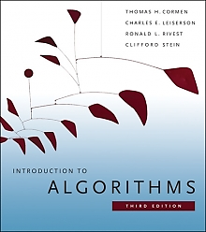
Introduction to Algorithms
(2nd edition)
by Cormen, Leiserson, Rivest & Stein
Chapter 2: Getting Started
(slides enhanced by N. Adlai A. DePano)

Slide 2
Overview
Aims to familiarize us with framework used throughout text
Examines alternate solutions to the sorting problem presented in Ch. 1
Specify algorithms to solve problem
Argue for their correctness
Analyze running time, introducing notation for asymptotic behavior
Introduce divide-and-conquer algorithm technique

Slide 3
The Sorting Problem
Input: A sequence of n numbers [a₁, a₂, … , a_{n}].
Output: A permutation or reordering [a'₁, a'₂, … , a'_{n} ] of the input sequence such that a'₁ ≤ a'₂ ≤ … ≤ a'_{n} .
An instance of the Sorting Problem:
Input: A sequence of 6 number [31, 41, 59, 26, 41, 58].
Expected output for given instance:
Expected
Output: The permutation of the input [26, 31, 41, 41, 58 , 59].

Slide 4
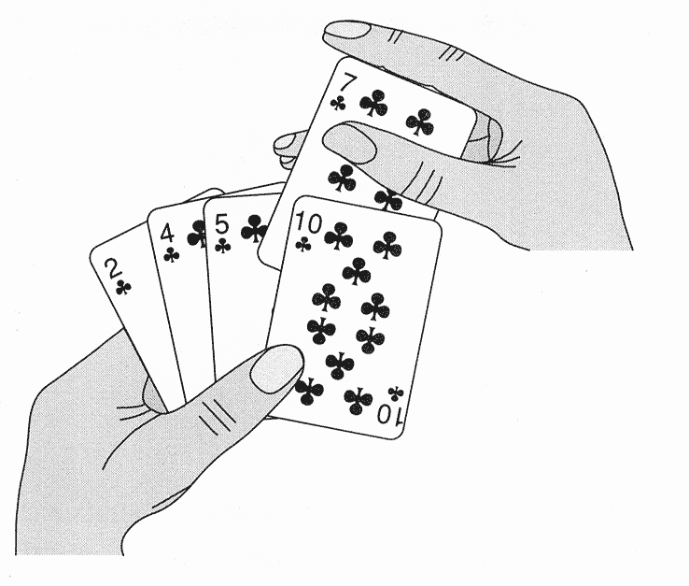
Insertion Sort
Copyright © The McGraw-Hill Companies, Inc. Permission required for reproduction or display.
The main idea …

Slide 5
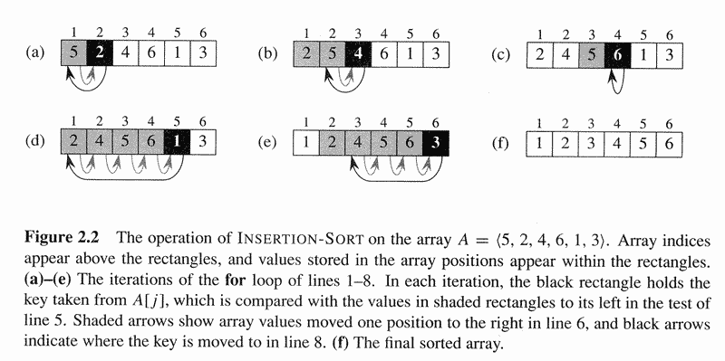
Copyright © The McGraw-Hill Companies, Inc. Permission required for reproduction or display.
Insertion Sort (cont.)

Slide 6
Copyright © The McGraw-Hill Companies, Inc. Permission required for reproduction or display.
Insertion Sort (cont.)

Slide 7
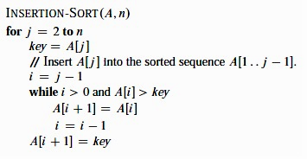
Copyright © The McGraw-Hill Companies, Inc. Permission required for reproduction or display.
Insertion Sort (cont.)
The algorithm …

Slide 8
Loop Invariant
Property of A[1 .. j − 1]
At the start of each iteration of the for loop of lines 1− 8, the subarray A[1 .. j − 1] consists of the elements originally in A[1 .. j − 1] but in sorted order.
Need to establish the following re invariant:
  Initialization: true prior to first iteration
  Maintenance: if true before iteration, remains true after iteration
  Termination: at loop termination, invariant implies correctness of algorithm

Slide 9
Analyzing Algorithms
Has come to mean predicting the resources that the algorithm requires
Usually computational time is resource of primary importance
Aims to identify best choice among several alternate algorithms
Requires an agreed-upon “model” of computation
Shall use a generic, one-processor, random-access machine (RAM) model of computation

Slide 10
Random-Access Machine
Instructions are executed one after another (no concurrency)
Admits commonly found instructions in “real” computers, data movement operations, control mechanism
Uses common data types (integer and float)
Other properties discussed as needed
Care must be taken since model of computation has great implications on resulting analysis

Slide 11
Analysis of Insertion Sort
Time resource requirement depends on input size
Input size depends on problem being studied; frequently, this is the number of items in the input
Running time: number of primitive operations or “steps” executed for an input
Assume constant amount of time for each line of pseudocode

Slide 12
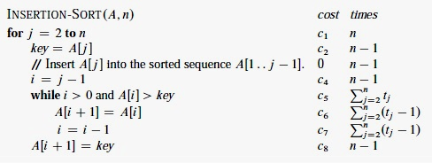
Copyright © The McGraw-Hill Companies, Inc. Permission required for reproduction or display.
Analysis of Insertion Sort
Time efficiency analysis …

Slide 13
Best Case Analysis
Least amount of (time) resource ever needed by algorithm
Achieved when incoming list is already sorted in increasing order
Inner loop is never iterated
Cost is given by:
T(n) = c₁n+c₂ (n−1)+c₄ (n−1)+c₅(n−1)+c₈(n−1)
= (c₁+c₂+c₄+c₅+c₈)n − (c₂+c₄+c₅+c₈)
= an + b
Linear function of n

Slide 14
Worst Case Analysis
Greatest amount of (time) resource ever needed by algorithm
Achieved when incoming list is in reverse order
Inner loop is iterated the maximum number of times, i.e., t_{j} = j
Therefore, the cost will be:
T(n) = c₁n + c₂ (n−1)+c₄ (n−1) + c₅((n(n+1)/2) −1) + c₆(n(n−1)/2)
+ c₇(n(n−1)/2) + c₈(n−1)
= ( c₅ /2 + c₆ /2 + c₇/2 ) n² + (c₁+c₂+c₄+c₅ /2 − c₆ /2 − c₇ /2 +c₈ ) n
− ( c₂ + c₄ + c₅ + c₈ )
= an² + bn + c
Quadratic function of n

Slide 15
Future Analyses
For the most part, subsequent analyses will focus on:
  Worst-case running time
    Upper bound on running time for any input
  Average-case analysis
    Expected running time over all inputs
Often, worst-case and average-case have the same “order of growth”

Slide 16
Order of Growth
Simplifying abstraction: interested in rate of growth or order of growth of the running time of the algorithm
Allows us to compare algorithms without worrying about implementation performance
Usually only highest order term without constant coefficient is taken
Uses “theta” notation
  Best case of insertion sort is Θ(n)
  Worst case of insertion sort is Θ(n²)

Slide 17
Designing Algorithms
Several techniques/patterns for designing algorithms exist
Incremental approach: builds the solution one component at a time
Divide-and-conquer approach: breaks original problem into several smaller instances of the same problem
  Results in recursive algorithms
  Easy to analyze complexity using proven techniques

Slide 18
Divide-and-Conquer
Technique (or paradigm) involves:
  “Divide” stage: Express problem in terms of several smaller subproblems
  “Conquer” stage: Solve the smaller subproblems by applying solution recursively – smallest subproblems may be solved directly
  “Combine” stage: Construct the solution to original problem from solutions of smaller subproblem

Slide 19
Merge Sort Strategy
n
(unsorted)
Divide stage: Split the n-element sequence into two subsequences of n/2 elements each
Conquer stage: Recursively sort the two subsequences
Combine stage: Merge the two sorted subsequences into one sorted sequence (the solution)
n/2
(unsorted)
n/2
(unsorted)
MERGE SORT
MERGE SORT
n/2
(sorted)
n/2
(sorted)
MERGE
n
(sorted)

Slide 20
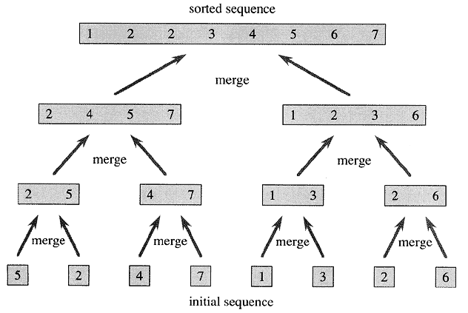
Copyright © The McGraw-Hill Companies, Inc. Permission required for reproduction or display.
Merging Sorted Sequences

Slide 21
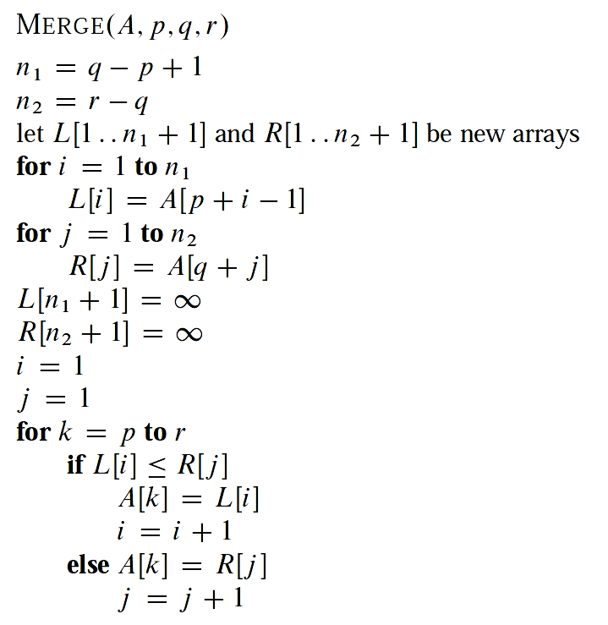
Copyright © The McGraw-Hill Companies, Inc. Permission required for reproduction or display.
Merging Sorted Sequences
Combines the sorted subarrays A[p..q] and A[q+1..r] into one sorted array A[p..r]
Makes use of two working arrays L and R which initially hold copies of the two subarrays
Makes use of sentinel value (∞) as last element to simplify logic
Θ(1)
Θ(n)
Θ(1)
Θ(n)

Slide 22
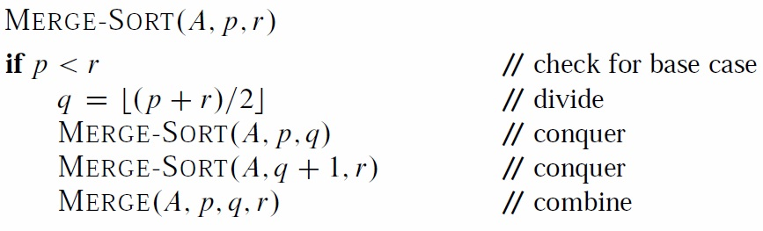
Merge Sort Algorithm
Θ(1)
T(n/2)
T(n/2)
Θ(n)
T(n) = 2T(n/2) + Θ(n)

Slide 23
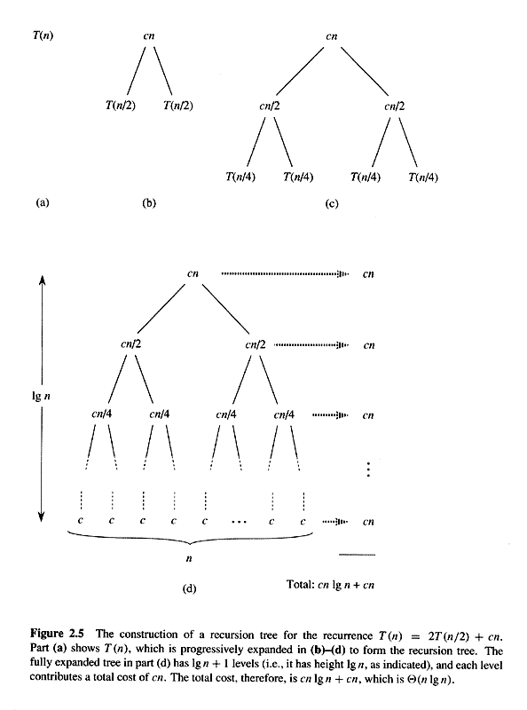
Copyright © The McGraw-Hill Companies, Inc. Permission required for reproduction or display.
Analysis of Merge Sort
Analysis of recursive calls …

Slide 24
Copyright © The McGraw-Hill Companies, Inc. Permission required for reproduction or display.
Analysis of Merge Sort
T(n) = cn(lg n + 1)
= cnlg n + cn
T(n) is Θ(n lg n)

